Slide 1

Blocking the Blocker – Studying the effects of Anti Ad-blocking
Rohit Gupta & Rohit Panda
Technische Universität München
Fakultät für Informatik
München, 26. Januar 2018

Slide 2
Contents
A
B
C
D
E

Slide 3
Introduction
Online advertisements drives the economy of the World Wide Web.
Promotional content (ads) have found their way into websites at different strategic locations on webpages.
Users are employing Ad-blockers citing user experience, privacy and protection against malware as the top reasons.
Publishers are employing Anti Ad-blockers, scripts and notifications that ask users to disable Ad-blocker tools.

Slide 4
Roadmap
In our paper, we study various aspects of Anti Ad-blockers including:
We study the usage of Ad-blocker scripts and their mechanisms
We discuss the methodology used in detecting Anti Ad-blockers
We discuss on the findings of our results for the data set
We analyse Anti Ad-blocker scripts
We discuss the economic impact of Anti Ad-blockers
We discuss the legality and ethical aspects of using Anti Ad-blockers
We discuss alternatives to Anti Ad-blocking

Slide 5
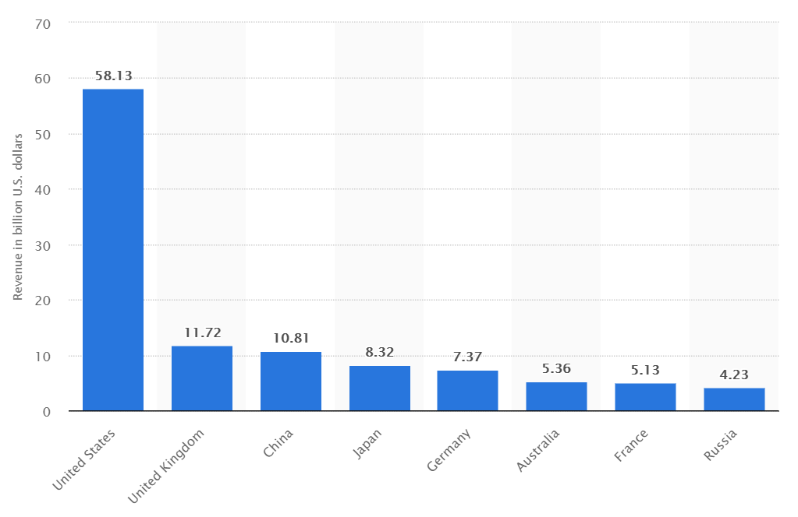
Revenue Generation for Ads
U.S. lead the market share with $58.13b revenue in 2017 followed by the U.K. with $11.72b and China with $10.81b
Source: www.statista.com

Slide 6
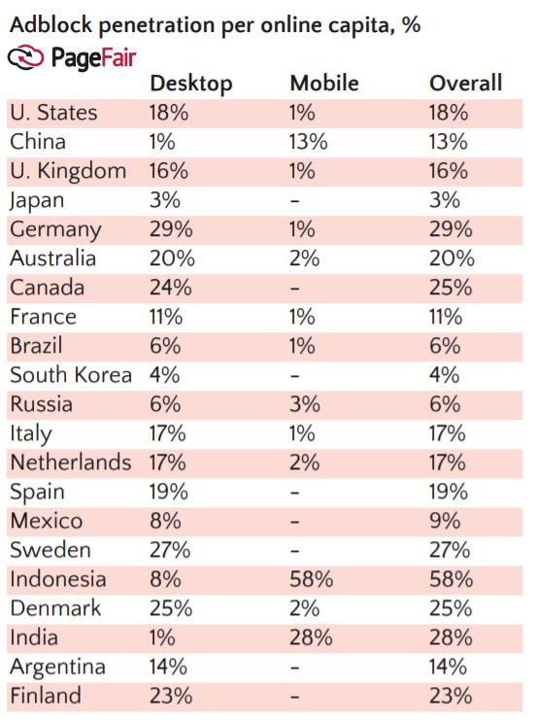
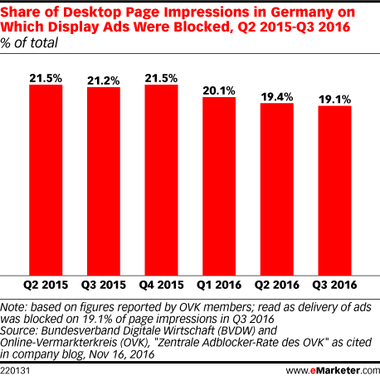
Ad-blocker popularity in Germany
PageFair Adblock penetration vs BVDW and OVK page impressions.
Source: PageFair and www.eMarketer.com

Slide 7
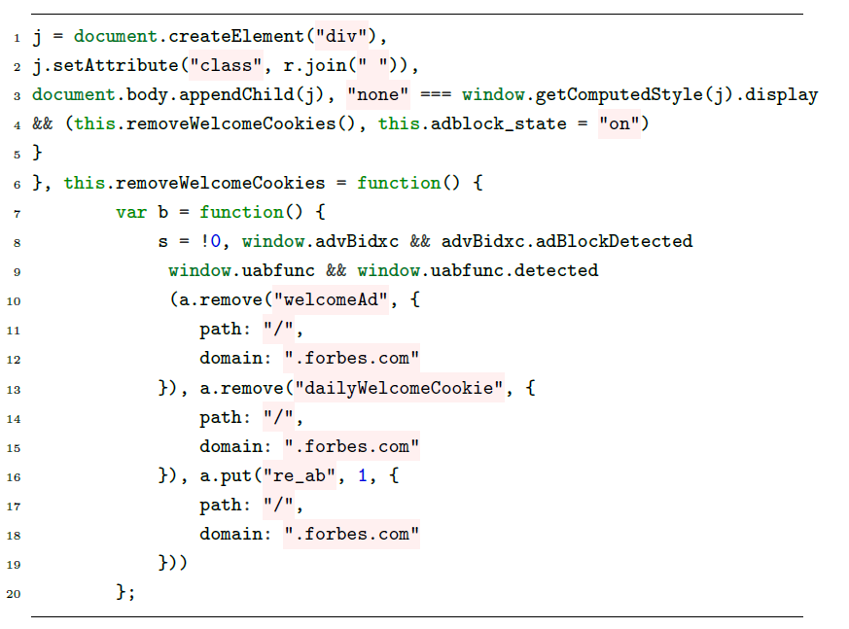
Ad-blocker scripts
Code showing how Forbes implements ads on their website

Slide 8
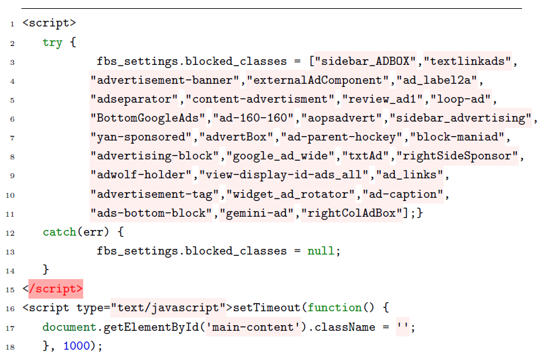
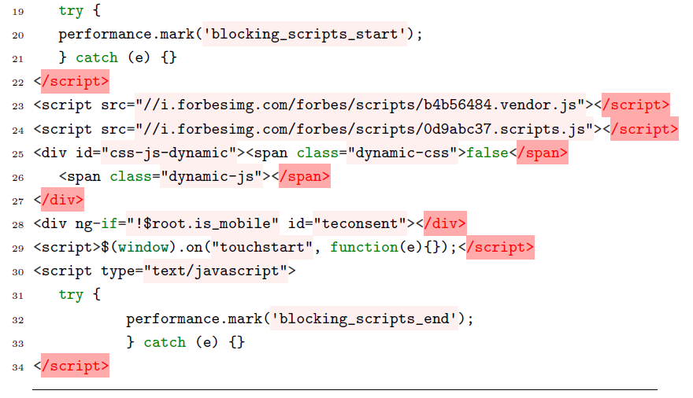
Ad-blocker scripts
Code showing how Forbes implements ad-blocker detection on their website

Slide 9




Ad-blocker extensions
μBlock Origin for Chrome and Firefox
AdBlock for Chrome
Adblock Plus for Firefox, Chrome, Opera and Safari
AdBlock Pro for Chrome
Adguard for Chrome and Firefox
AdRemover for Chrome
Ghostery for Chrome, Firefox, Opera, Safari, Internet Explorer, Android and iPhone iOS
Simply Block Ads! for Chrome
SuperBlock AdBlocker for Chrome
μ Adblock for Firefox
uMatrix for Firefox, Chrome and Opera

Slide 10
Detecting Anti Ad-blockers
Anti Ad-blocker scripts change HTML content by:
adding extra HTML elements,
change in style of existing HTML elements,
changes in textual context.
These changes can be categorized into:
Node Changes: Extra DOM elements
Style Changes: Toggling of hidden div elements
Textual Changes: Changes in textual content
Structural Changes: URL redirections

Slide 11
Detecting Anti Ad-blockers: Methodology
Anti Ad-blocker scripts change HTML content by:
adding extra HTML elements,
change in style of existing HTML elements,
changes in textual context.
These changes can be categorized into:
Node Changes: Extra DOM elements
Style Changes: Toggling of hidden div elements
Textual Changes: Changes in textual content
Structural Changes: URL redirections

Slide 12
Thank you!

